Slide 1

Multimodal LLM Optimizations CIS 7000 - Fall 2024
Presenters: Wahub Ahmed, Vridhi Jain, Om Shastri, Vignesh Lakshmanan

Slide 2
Outline
Motivation for Vision-Language MLLM
Flamingo
mPLUG-Owl 2
JanusFlow
Conclusion

Slide 3
Motivation for Vision-Language MLLM
Chapter 1

Slide 4

A Picture is Worth a Thousand Words
vs. “The Starry Night” by Vincent Van Gogh
Notes:
LLMs emerged as powerful tools for NLP and generation. However, real world scenarios typically need to interact with multiple input formats like humans do. Though agentic frameworks exists with tool usage, non-text input formats are left out.
Consider for example providing a transformer model with an image of Van Gogh’s famous painting the starry night with a text label, versus solely providing the text label.
The picture may seems like redundant information to add since both the image and text describe the same idea or object. With the picture, you have to have millions of pixels each with an rgb value, a higher dimensional representation. However, the extra information in the picture such as the art style, color scheme, and the texture can be extrapolated in a way that the text itself cannot extrapolate.

Slide 5
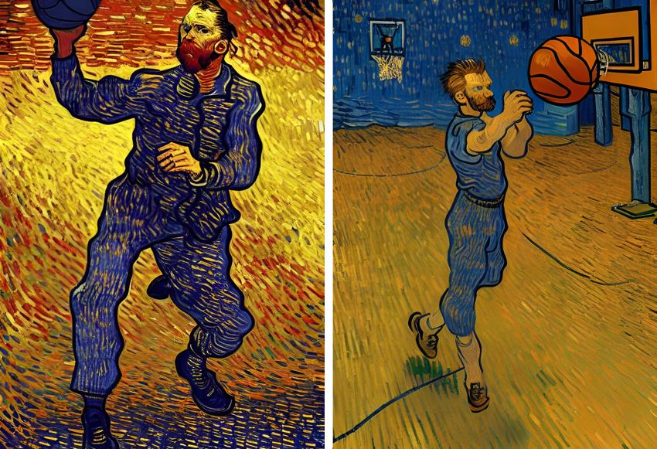
A Picture is Worth a Thousand Words
Generation
Notes:
So images are a powerful piece of input that can replicate and improve generative capabilities models that form these inputs. By doing so, the model improves their understanding of the world and can reason more effectively by comparing multiple sources of information.

Slide 6
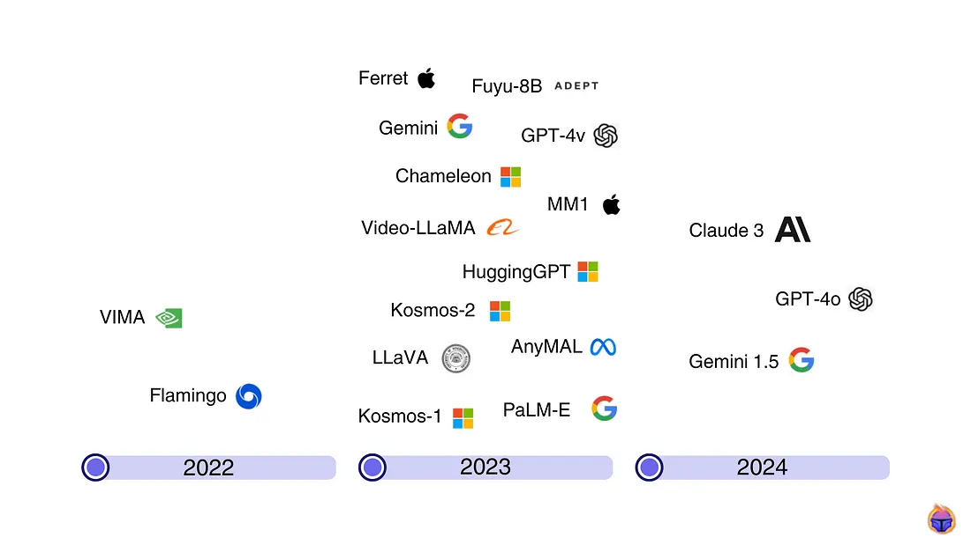
Evolution of Multimodal LLM
Notes:
Though a novel field, it is rapidly expanding. The earliest example of multimodality was Vision Transformer, which are now replaced by MLLMs. Most big tech companies developed at least one MLLM, most prominent of which gpt-4o

Slide 7
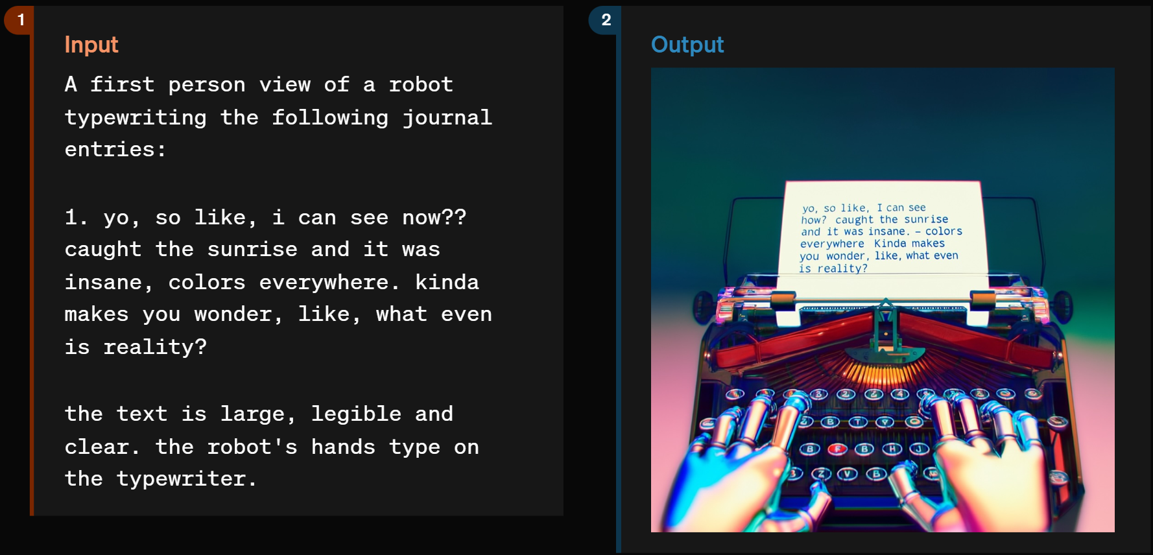
Example: GPT-4o
Notes:
Example text instructions and output image

Slide 8
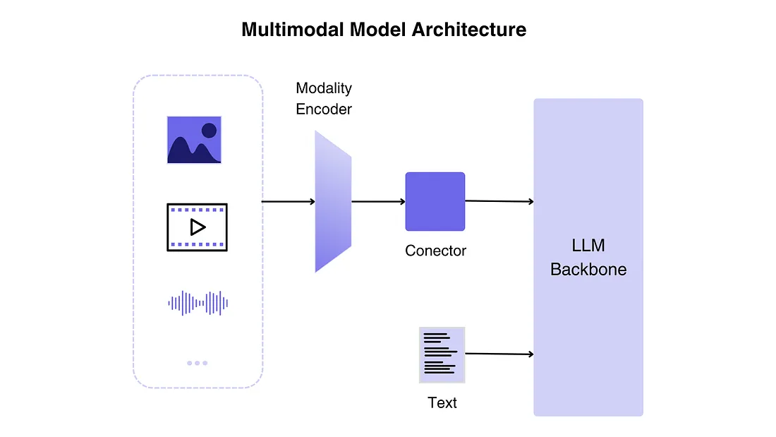
Multimodal LLM Architecture
Notes:
Generally MLLMs follow this pattern:
You have your standard text input along with images, video, audio, etc that go into the
Modality encoder: The encoding components condense raw data formats like visuals or sound into a more streamlined representation. Instead of training from the ground up, use a pre-trained encoder that has been calibrated to other modalities.
Connector: functions as a link between the encoder and the LLM. Converts the modalities to an embedding that can be used with text, since LLMs can only interpret text
LLM backbone: A language model is required to output responses in text. It acts as the “brain” of the MLLM.

Slide 9
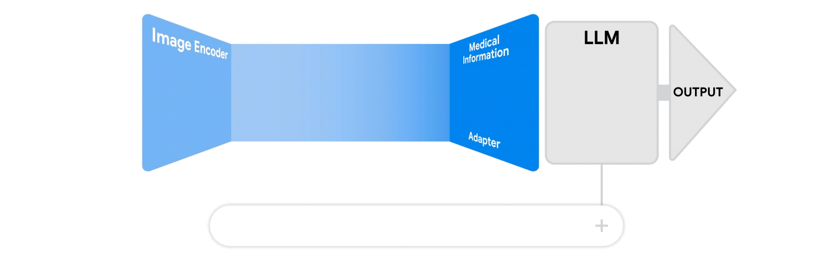
Why Optimize Vision-Language LLMs?
Notes:
We want to optimize on a particular set of tasks. We faced problems in LLMs when we gave it large corpus of text and didn't specify an architecture around specific tasks. Thus we got the next most likely token which made it useless for QA or text summarization tasks. This problem is magnified if we have a large corpus of text, image, video, audio data, and do not specialize it for tasks
Moreover, with the additional information overhead from images, we need more efficient and simplified architectures that are easier to interpret while still performing well on benchmarks.

Slide 10
MLLM 1: Flamingo
Chapter 2

Slide 11
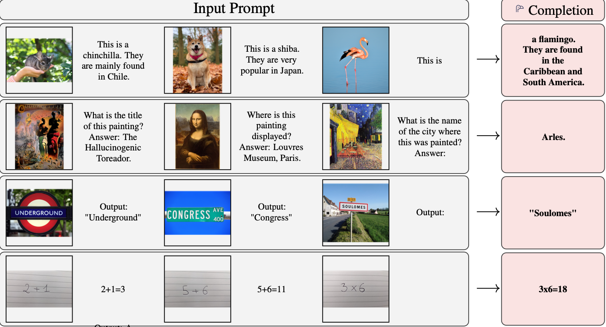
Flamingo: a Visual Language Model for Few-Shot Learning
What is Flamingo? A multimodal model that combines vision and language for few-shot learning, enabling robust performance across diverse tasks without task-specific fine-tuning.
Motivation:
Traditional visual models require task specific fine tuning and large annotated datasets.
Flamingo addresses this by enabling few shot learning across image, video and text tasks
References/Image credits
J-B. Alayrac et al., "Flamingo: a Visual Language Model for Few-Shot Learning", arxiv (2022)
Notes:
The first paper is Flamingo: … by Jean-Baptise Alaric and co-authors from deepmind, published in 2022.
Flamingo is a multimodal model that combines vision and language for few-shot learning, enabling robust performance across diverse tasks without task-specific fine-tuning.
Motivation:
Traditional visual models require task specific fine tuning which in turn require large annotated datasets, per task hyperparameter tuning and also manual labeling making the process very computationally expensive.
There were some state of the art models that like CLIP, ALIGN which explored zero shot learning which did pretty well on close-ended tasks however could not generalize over open-ended tasks such as Visual-question answering, image captioning etc. This was because they were very good at selecting appropriate (image, text) pairs from predefined list of categories however they could not generate text.
So the authors explored if we could train a multimodal model to work well in a few shot learning regime just from a handful of examples with minimum computation. Here are a few examples of various tasks handled by flamingo: ….

Slide 12
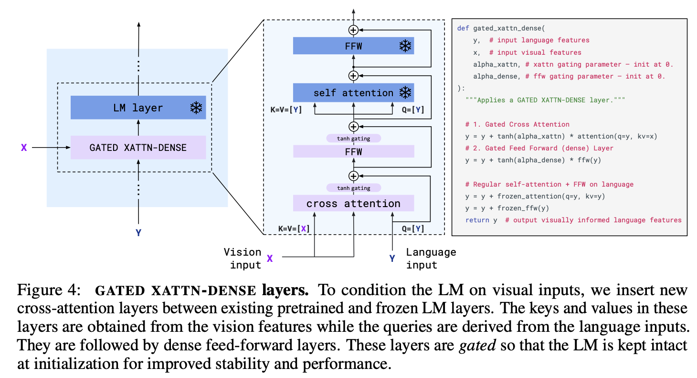
Bridge powerful pretrained vision-only and language-only models
Training from scratch is extremely
computationally expensive
Start from a pre trained language model
Text-only model has no built-in way to
incorporate input from other modalities.
Flamingo: interleave cross-attention layers with
language-only self-attention layers (frozen)
References/Image credits
J-B. Alayrac et al., "Flamingo: a Visual Language Model for Few-Shot Learning", arxiv (2022)
Notes:
This paper addresses three challenges, the first one being bridging powerful pretrained vision only and language only models.
The authors saw that in principle visual tasks are also text prediction problems with visual input conditioning, they wanted to build a model capable of these tasks with large scale pretraining.
So we start from a pretrained language model, here chinchilla family was used. However Text-only model has no built-in way to incorporate input from other modalities.
Flamingo uses interleaved gated cross-attention layers with language-only self-attention layers kept frozen during multimodal training. Each gated block includes cross attention layer with (key, value) derived from visual inputs while queries derived from language inputs. Here Tanh gates are used to preserve the original language model behavior at initialization. At initialization, When α=0, the value of tanh(0)=0. This completely blocks the visual input, ensuring the language model functions as it would in its original, pretrained state. As training progresses and α learns task-specific values, tanh(α) gradually adjusts the flow of information.

Slide 13
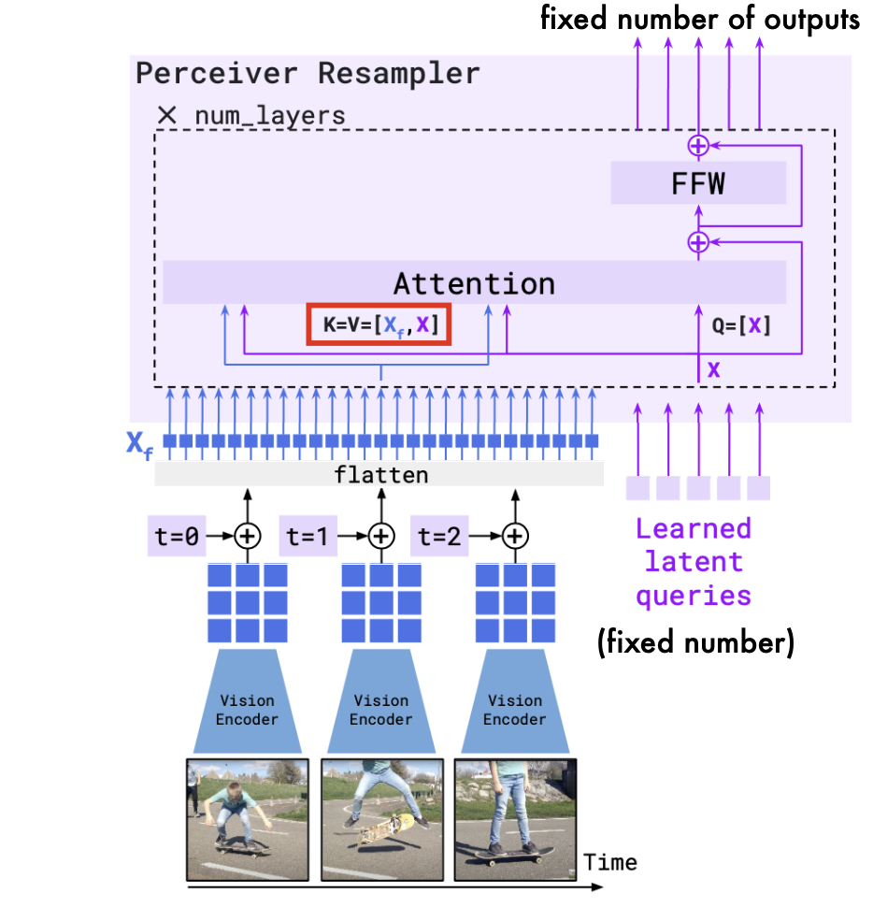
Unified handling of images and videos
Both image and video inputs are high dimensional
Flattening these inputs into 1-D sequences as is done in text generation, is computationally expensive
It is exacerbated by the quadratic cost of self-attention layers
Flamingo: Uses a perceiver-resampler processes inputs into fixed visual tokens, incorporates temporal encodings for videos and combines learned latent queries with visual embeddings through attention.
Notes:
The second challenge addressed by the authors is unified handling of images and videos. Both image and video inputs are high dimensional. Flattening these inputs into 1-D sequences as is done in text generation, is computationally expensive. It is made worse by the quadratic cost of self-attention layers
For this reason, flamingo uses a perceiver-resampler processes inputs into fixed visual tokens, in our paper it was 64. Here we can see that video frames are fed to frozen vision encoder which outputs variable number of features which are then incorporated with temporal encodings for videos to capture the sequential relation between the frames and flattened as key,value inputs and then combined with learned latent queries through attention and then fed to fed forward layer to get a fixed number of visual tokens.

Slide 14
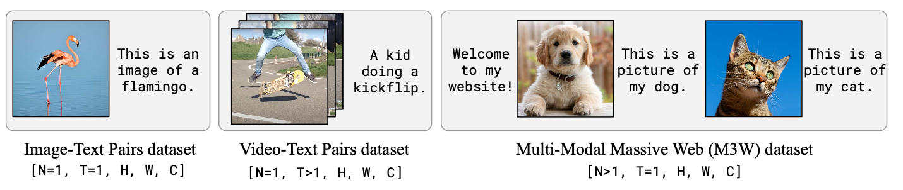
Training Dataset
The existing (image, text) datasets used by CLIP or ALIGN are not general enough for few shot learning
Multimodal datasets are scarce in comparison to abundantly available text-only data
One approach is to scrape web pages for interleaved images and text however these pairs are often only weakly related
Flamingo: combines web scraping with existing paired (image, text) and (video, text) datasets
Notes:
The third challenge that was addressed by the authors was that the existing (image, text) datasets used by CLIP or ALIGN were not general enough for few shot learning as discussed before. So it was proposed to scrape web pages for interleaved images and text however these pairs are often exhibit weak relationship making them less effective.
Thus it was proposed that in flamingo will use combination of web scraping with existing paired (image, text) and (video, text) datasets

Slide 15
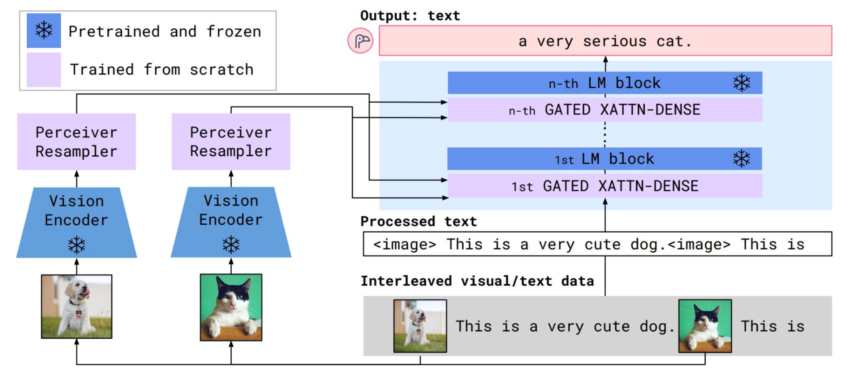
Flamingo Architecture
References/Image credits
J-B. Alayrac et al., "Flamingo: a Visual Language Model for Few-Shot Learning", arxiv (2022)
Notes:
This is the complete architecture of flamingo wherein input is interleaved visual and text data to get the output of free form text data.
Here, for example, the input of the image of a dog with the description followed by the image of a cat with partial text “This is” is given as an input in two ways. The input text is processed to include placeholders for the images, which translates to image tag This is a very cute dog. Image tag This is… and the images are also fed into the frozen pretrained vision encoders to get high dimensional features and then passed through perceiver resampler to get our visual tokens. Both are then fed into gated cross attention blocks. The cross-attention mechanism integrates the visual and textual data while preserving the original behavior of the frozen language model. The combined representations are passed into the frozen language model (e.g., Chinchilla) to get the final output of free-form text “a very serious cat.”

Slide 16
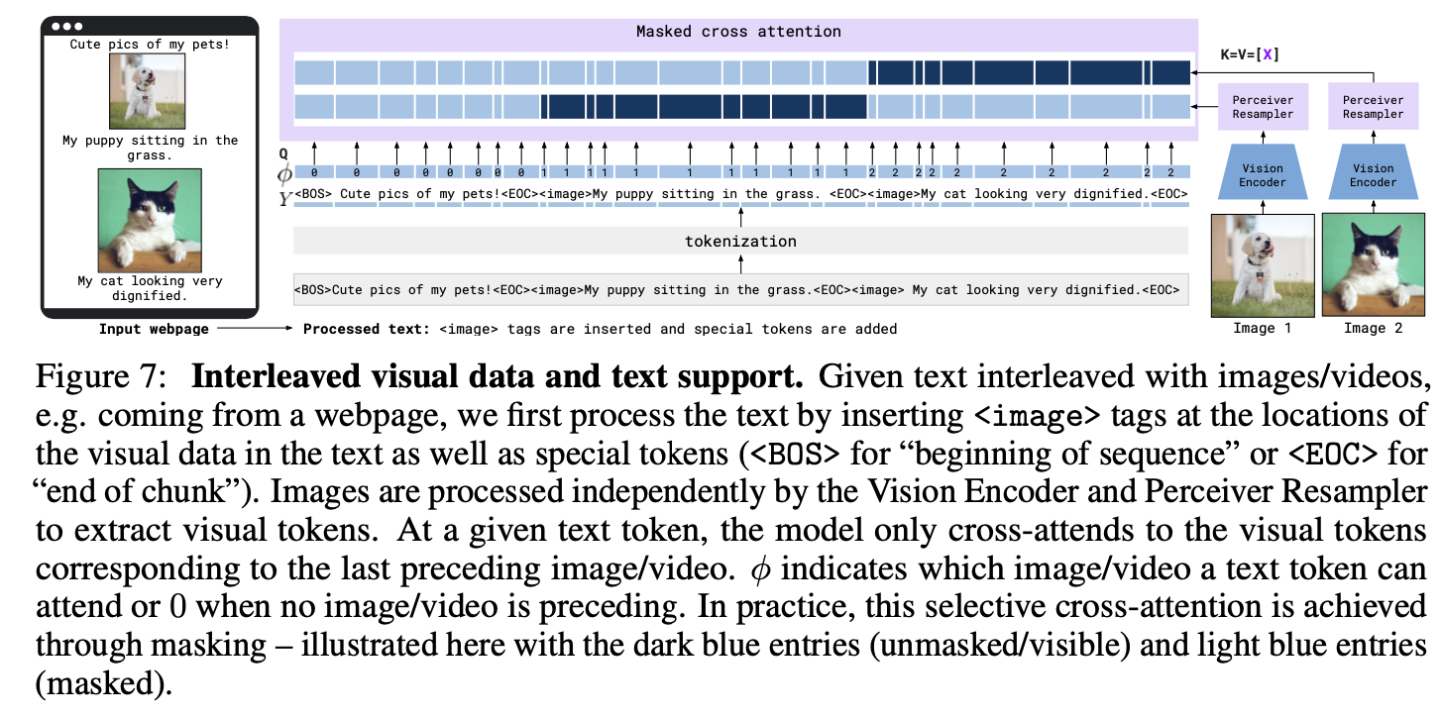
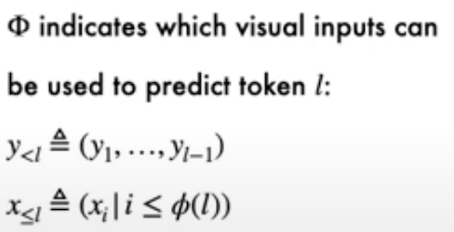
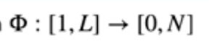
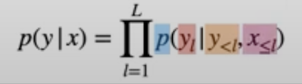
Attention Masking in Flamingo
masked
unmasked
Notes:
This diagram illustrates how Flamingo processes input data. Each sequence consists of interleaved sequence of text y, sequence of images/videos x and the sequence indicating positions of images/videos in text.
Each image is processed independently by the Vision Encoder and Perceiver Resampler, which extracts fixed-size visual tokens.
And here, the text is first tokenized, and special tokens like <BOS> (Beginning of Sequence) and <EOC> (End of Chunk) are added. <image> tags are also inserted to represent image locations. After tokenization, to create appropriate mask, the authors designed a function Φ that assigns each text position, an integer between 1 and N which represents the index of image/video that appeared immediately before the sequence and If no visual data appears before it then a value of 0 is assigned. Τhis function is useful as it can be used to indicate which visual inputs can be used to predict the token at position L, when computing the likelihood expression.
The attention mechanism uses selective masking. For each text token, the model attends only to visual tokens corresponding to the preceding image or video. For instance, the dark blue areas show unmasked attention, while the light blue areas indicate masked regions. Although it seems restrictive, since the direct attention is only on a single image, there is still causal dependency on previous images due to causal self-attention in the text decoder.
This ensures the model effectively captures the relationship between text and visual context with higher precision.

Slide 17
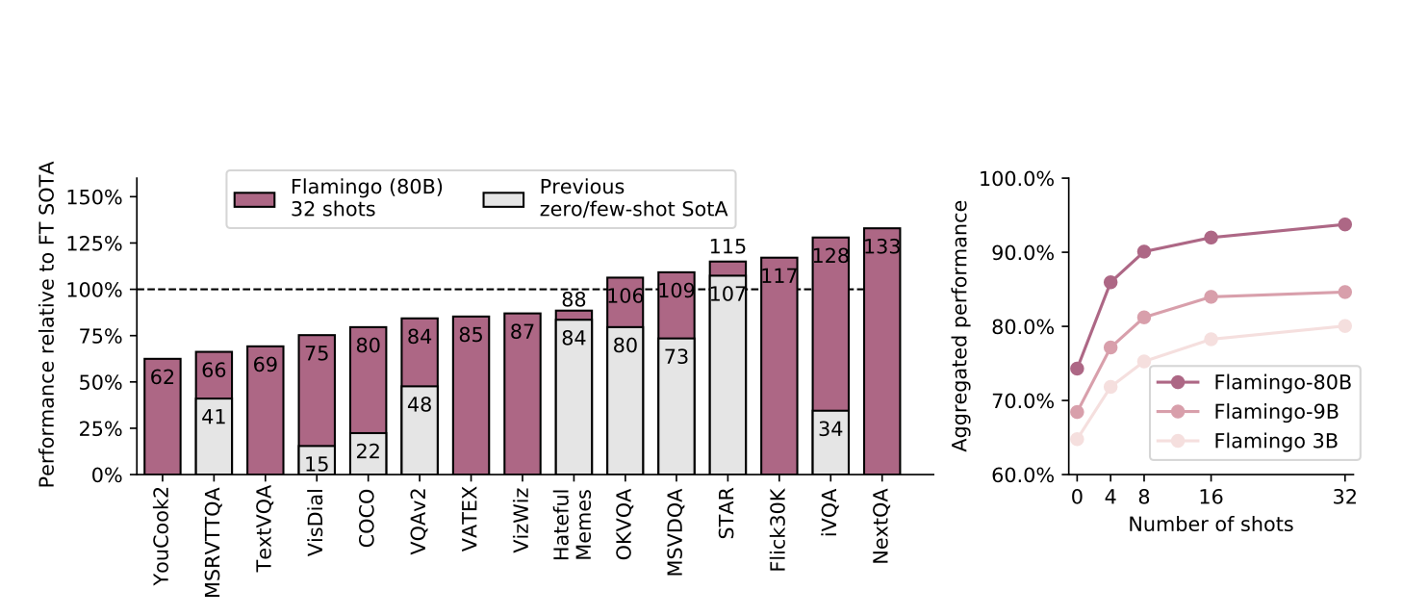
Results
Notes:
The results demonstrated that flamingo outperformed the previous zero/few shot models across 16 benchmarks for a variety of tasks and even outperforming finetuned models over 6 benchmarks mainly used for visual question answering and image captioning tasks.

Slide 18
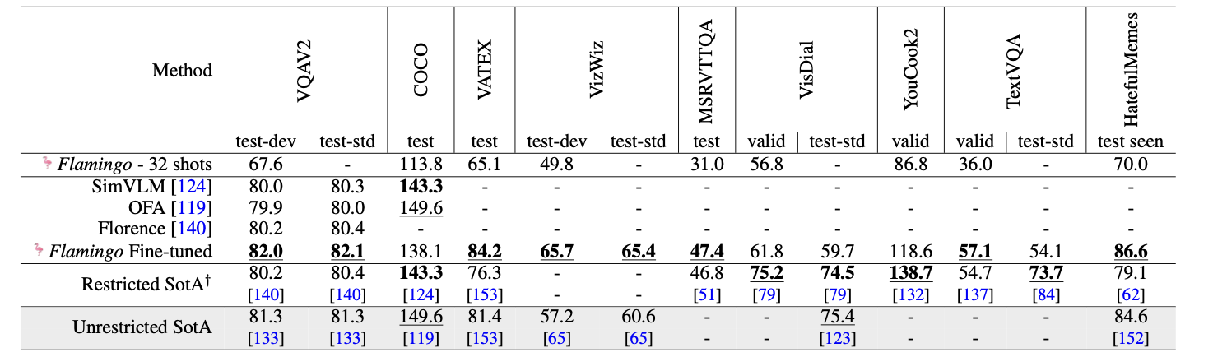
With Finetuning
During fine-tuning, Flamingo keeps the language model layers frozen
The base vision encoder is also fine-tuned (unlike Flamingo pretraining)
Hyperparameters are set by grid search on validation subsets of the training sets
Search over: learning rate, decay schedule, training steps, batch size, augmentation
Notes:
Although not the focus of the paper but the performance of finetuned flamingo was also observed wherein
During fine-tuning, Flamingo keeps the language model layers frozen. The base vision encoder is also fine-tuned (unlike Flamingo pretraining). Hyperparameters are set by grid search on validation subsets of the training sets. Search over: learning rate, decay schedule, training steps, batch size, augmentation
It was observed that fine-tuning significantly improved performance, especially for task-specific applications
One of the key limitations identified in the study was that the hallucinations from the pretrained model were carried over to the open-ended tasks, affecting the reliability of responses in some scenarios.. Future works can be expanded to include other modalities such as audio since this was only focused on visual-text.

Slide 19
MLLM 2: mPLUG-Owl 2
Chapter 3

Slide 20
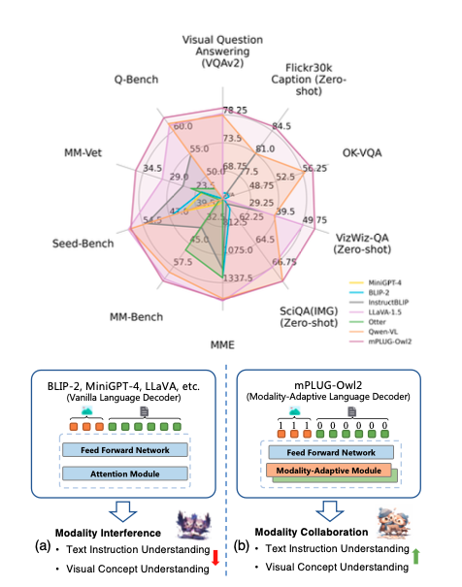
mPLUG-Owl2: Revolutionizing Multi-modal LLMs with Modality Collaboration
- The modality-adaptive module (MAM) allows the model to differentiate between modalities
- Generalizes on both text and multi-modal tasks
- Stands as the first MLLM model to exhibit the phenomena of modality collaboration in both pure-text and multi-modal contexts
- Extends original mPlug-OWL Paper

Slide 21
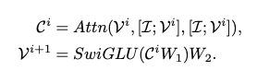
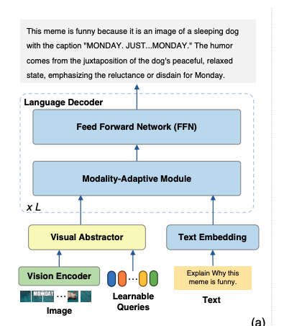
Model Architecture
- Encodes image into token with Encoder and Abstractor
- Encoder Processes image into tokens
- Abstractor uses attention and activation reducing image redundancy and compute
- Embeddings are Concatenated with text Embedding
- FFN promotes modality collaboration

Slide 22
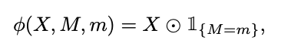
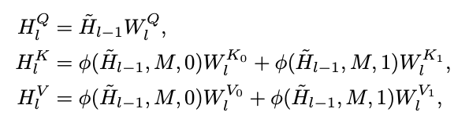
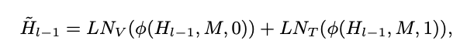
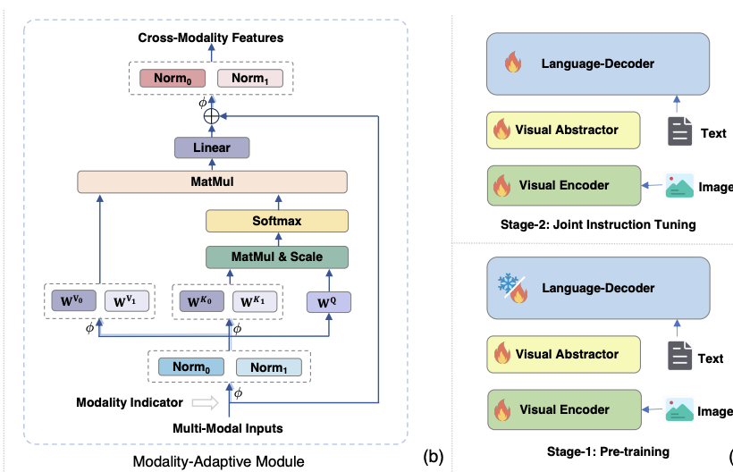
Training and Modality Adaptive Module
MAM:
Normalizers allows for modalities to be considered equally
Attention block after separating tokens on modality and expressing in shared semantic space
Training:
Pretrain modalities separately
Tune on joint instructions
Keep vision encoder trainable across both stages

Slide 23
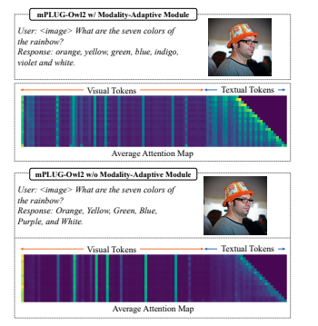
Results and Discussion
Multi-modal Tasks: Outperforms other models in captioning, VQA, and multi-modal benchmarks, even in zero-shot scenarios.
Text Tasks: Demonstrates strong reasoning and language understanding, surpassing instruction-tuned LLMs.
Incorporation of MAM offsets performance degradation in text settings
Number of Abtractor’s learnable queries improves performance until saturation point
Improved Robustness in Unrelated Modality Scenarios

Slide 24
MLLM 3: JanusFlow
Chapter 4

Slide 25
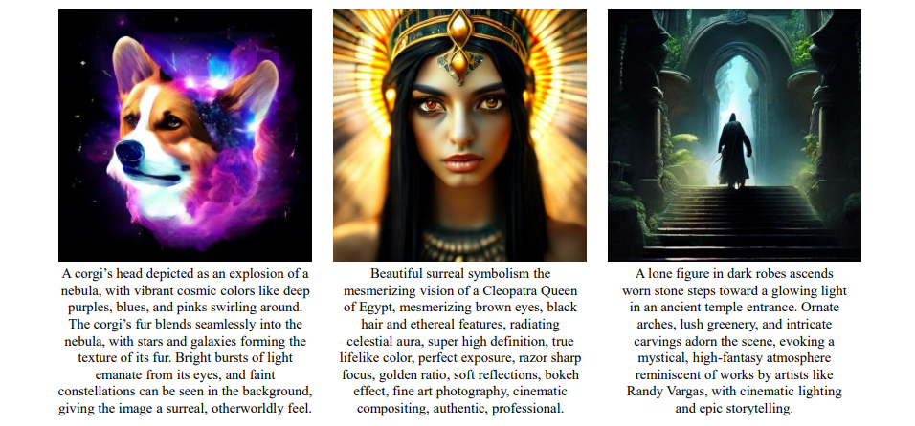
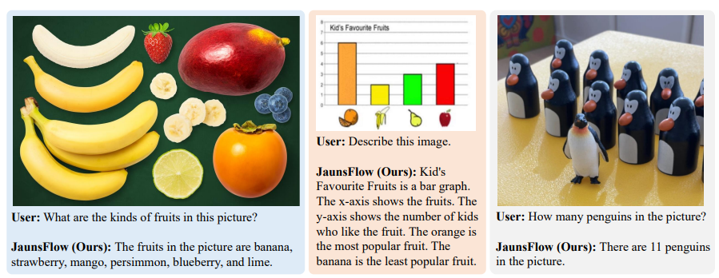
JanusFlow: Harmonizing Autoregression and Rectified Flow
Unified Architecture: Combines autoregressive language models with rectified flow for both image understanding and generation.
Decoupled Encoders: Separate vision encoders for understanding and generation to reduce task interference.
Representation Alignment: Aligns intermediate representations between generation and understanding modules for enhanced semantic coherence.
Notes:
JanusFlow, introduced in November 2024 by Yiyang Ma and collaborators from DeepSeek-AI, Peking University, The University of Hong Kong, and Tsinghua University, is a groundbreaking framework that unifies autoregression and rectified flow for multimodal understanding and generation. To understand its significance, let’s break down these terms. Autoregression is a predictive modeling technique where the model forecasts the next element in a sequence based on prior inputs. This process is common in tasks like text generation, where a model predicts the next word in a sentence by analyzing the context of the previous words. For example, given the phrase "The sun is," an autoregressive model might predict the next word to be "shining" or "rising," depending on the context. This ability to anticipate sequences is crucial for generating coherent and contextually relevant outputs.
Rectified flow, on the other hand, is a method used in generative modeling to create structured outputs like images. It begins with random noise, which the model refines step by step into a meaningful representation. Imagine a sculptor starting with a rough block of marble and gradually chiseling it into a detailed statue. Similarly, rectified flow transforms randomness into coherent images by following mathematical guidelines, allowing JanusFlow to generate high-quality visuals from textual descriptions. This method simplifies the complex architectures often required for image generation while maintaining exceptional quality and precision.
One of JanusFlow's key innovations is its use of decoupled encoders. In traditional multimodal systems, a single encoder is often tasked with handling both understanding and generation tasks. This can lead to interference, where the needs of one task, like understanding an image, conflict with the requirements of another task, such as generating a new image. JanusFlow solves this by assigning separate encoders to each task. This is akin to having two specialized translators—one for technical documents and another for poetry—ensuring each task is handled with optimal focus and accuracy. This separation enhances the model’s ability to perform both tasks at a high level without compromising on quality.
Another critical feature is representation alignment, which harmonizes the internal "thought processes" of the model's understanding and generation components. During training, JanusFlow ensures that the intermediate representations of data—essentially how the model internally interprets information—are aligned between the two tasks. This alignment results in outputs that are both contextually logical and visually consistent. For instance, when asked to generate an image of "a corgi blending into a nebula," JanusFlow not only produces a visually stunning image but also ensures that the generated image matches the described concept in both detail and essence.
The capabilities of JanusFlow are best illustrated through examples. For image generation, it can create visuals such as a surreal corgi merging into a nebula, where vibrant cosmic colors blend seamlessly with the animal's features. It can also generate lifelike portraits, such as a depiction of Cleopatra with detailed features, realistic lighting, and cinematic effects. In high-fantasy scenarios, it can craft intricate scenes like a lone figure ascending temple steps, capturing the mood and complexity of such settings. On the understanding side, JanusFlow excels in tasks like identifying objects in images—for example, recognizing bananas, strawberries, and blueberries in a fruit display. It can interpret data visualizations, such as describing the key insights from a bar graph, or count objects, like identifying 11 penguins in a group photo.
JanusFlow’s introduction marks a significant milestone in multimodal AI systems. By combining autoregression and rectified flow into a unified architecture, it simplifies traditionally complex designs while achieving state-of-the-art performance in both understanding and generation tasks.

Slide 26
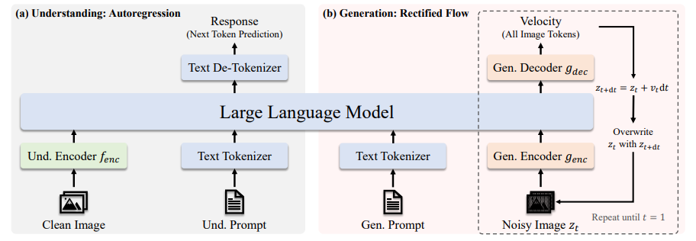
JanusFlow Architecture
Notes:
This slide illustrates the architecture of JanusFlow, highlighting how it integrates autoregressive modeling for understanding and rectified flow for image generation into a single unified framework. The architecture is divided into two main components: Understanding and Generation, which work seamlessly together to handle multimodal tasks.
On the left side, the process for visual understanding is shown, relying on an autoregressive approach. This starts with a clean image that is fed into the Understanding Encoder (f_enc). The encoder extracts meaningful features from the image and transforms them into a format that can be processed by the model. Simultaneously, an understanding prompt, such as text describing the task, is tokenized into discrete elements. Both the encoded image features and the tokenized text are passed into the Large Language Model (LLM), which predicts the next token in the sequence based on the given inputs. This autoregressive mechanism allows the model to generate a textual response step by step, such as a description of the image or answers to specific visual questions. The response is finally de-tokenized into human-readable text.
The right side depicts the image generation pipeline, which employs rectified flow, a generative modeling technique. The process begins with a noisy image, represented as a latent vector, which is essentially random noise. Alongside this, a generation prompt, such as a textual description of the desired image, is tokenized and used to guide the generation. The noisy input is processed by the Generation Encoder (g_enc), and the Generation Decoder (g_dec) predicts the next step in refining the noise. The model uses a mathematical function called velocity to iteratively transform the noise into a coherent image. This iterative refinement continues until the noise evolves into a fully realized image that matches the input prompt.
The integration of both processes within the Large Language Model is central to JanusFlow’s architecture. By using task-specific encoders and decoders, the model optimizes for both understanding and generation while avoiding interference between the tasks. The decoupled design allows the model to achieve high performance in each domain, whether it’s describing visual content or creating high-quality, semantically accurate images.

Slide 27
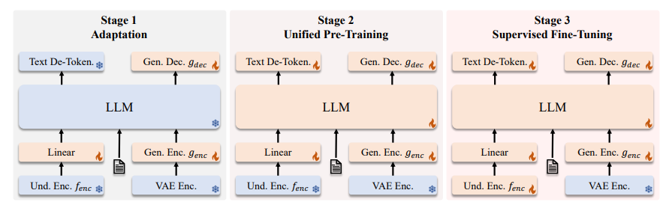
JanusFlow Training
Notes:
The "JanusFlow Training" slide illustrates the three stages of training in the framework: Adaptation, Unified Pre-Training, and Supervised Fine-Tuning. These stages are carefully designed to progressively build the model’s capability to handle complex multimodal tasks, starting from initialization to task-specific optimization.
In Stage 1: Adaptation, the focus is on initializing the components of the system and aligning them with the central Large Language Model (LLM). The Understanding Encoder (f_enc) processes input images and extracts features, while the Generation Encoder (g_enc) and Variational Autoencoder (VAE Encoder) prepare the model to handle noisy representations used in image generation. The Text De-Tokenizer and Generation Decoder (g_dec) handle outputs for text and image generation, respectively. Additionally, Linear Mapping Layers are introduced to adapt the outputs of these encoders to the LLM’s input requirements. At this stage, the system focuses on setting the foundation by aligning its individual components without fine-tuning the LLM itself.
In Stage 2: Unified Pre-Training, the goal is to train the entire system holistically using multimodal datasets. This phase integrates the Understanding and Generation pipelines, enabling the model to handle a range of tasks, such as image-text understanding and text-to-image generation. Both the LLM and the task-specific components, including the VAE Encoder and Decoder, are trained to work together. Linear layers and tokenization processes are also refined to ensure smooth communication between the components. This stage ensures that the tasks of understanding and generation are aligned within a single model, leveraging shared representations for enhanced performance.
Finally, Stage 3: Supervised Fine-Tuning focuses on optimizing the model for specific tasks using labeled datasets. During this stage, the Understanding Encoder, Generation Encoder/Decoder, and LLM are fine-tuned collaboratively to achieve task-specific excellence. Labeled data enables the model to learn explicit mappings between inputs, such as images or prompts, and desired outputs, such as captions, descriptions, or generated visuals. This supervised learning ensures that the model is not only accurate but also contextually relevant, making it highly effective for specialized applications like visual question answering or creative content generation.

Slide 28
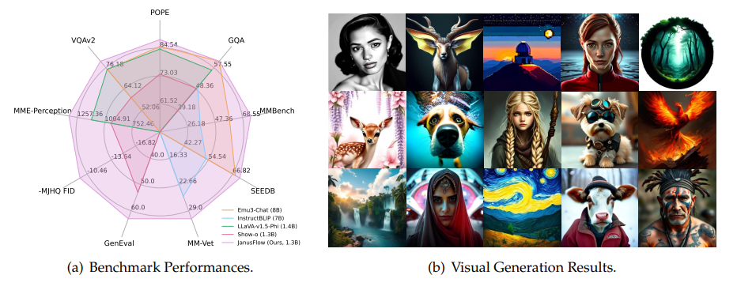
Results
Outperforms state-of-the-art unified and task-specific models on multimodal benchmarks (e.g., MMBench, SEEDBench, GQA).
Superior image generation quality with an MJHQ FID-30k score of 9.51, surpassing models like SDXL and Janus.
Notes:
This slide highlights the exceptional performance of JanusFlow across multiple benchmarks and tasks, emphasizing its ability to surpass existing models in both understanding and generation capabilities.
First, JanusFlow outperforms state-of-the-art unified and task-specific models on a variety of multimodal benchmarks, including MMBench, SEEDBench, and GQA. These benchmarks are widely recognized for evaluating the performance of models across tasks such as visual question answering, multimodal reasoning, and perception. For instance:
MMBench tests the general multimodal understanding and reasoning abilities of the model.
SEEDBench focuses on scenarios involving multimodal dialogue and understanding.
GQA measures the accuracy of visual question answering tasks, particularly testing a model's logical reasoning and contextual comprehension of images.
The radar chart on the left provides a comparative view of JanusFlow's performance across these benchmarks. The purple lines represent JanusFlow, which clearly surpasses competing models like SDXL and Janus in nearly every metric. This demonstrates JanusFlow’s dominance in multimodal understanding and its ability to generalize across diverse tasks.
Second, JanusFlow sets a new standard in image generation quality, achieving an MJHQ FID-30k score of 9.51. The FID (Fréchet Inception Distance) metric is a standard for measuring the quality of generated images by comparing them to real images in terms of feature similarity. A lower score indicates higher-quality images that are more realistic and closer to human-generated visuals. With its score of 9.51, JanusFlow not only outperforms state-of-the-art models like SDXL and its predecessor, Janus, but also achieves a new level of realism and precision in image generation.
The images on the right further illustrate JanusFlow's ability to generate visually compelling and semantically accurate outputs. From lifelike portraits to surreal, imaginative visuals such as a glowing orb in a mystical setting or a fantastical creature, these examples showcase the model's versatility and ability to meet diverse creative and functional needs.
In conclusion, the results solidify JanusFlow’s position as a leading multimodal system. It excels in both understanding tasks, as demonstrated by benchmark performances, and in generation tasks, producing high-quality visuals.

Slide 29
Conclusion
Chapter 5

Slide 30
Summary of MLLMs
Flamingo: Visual language model designed for few-shot learning in vision and language tasks
mPLUG-Owl2: Leverages modality collaboration to improve performance in both text and multi-modal tasks
JanusFlow: Minimalist architecture that integrates autoregressive language models with rectified flow for both image understanding and generation
Notes:
3. **Flamingo**: Develops a visual language model designed for few-shot learning in vision and language tasks[5].
2. **mPLUG-Owl2**: Focuses on leveraging modality collaboration to improve performance in both text and multi-modal tasks[2].
1. **JanusFlow**: Introduces a minimalist architecture that integrates autoregressive language models with rectified flow for both image understanding and generation[4].

Slide 31
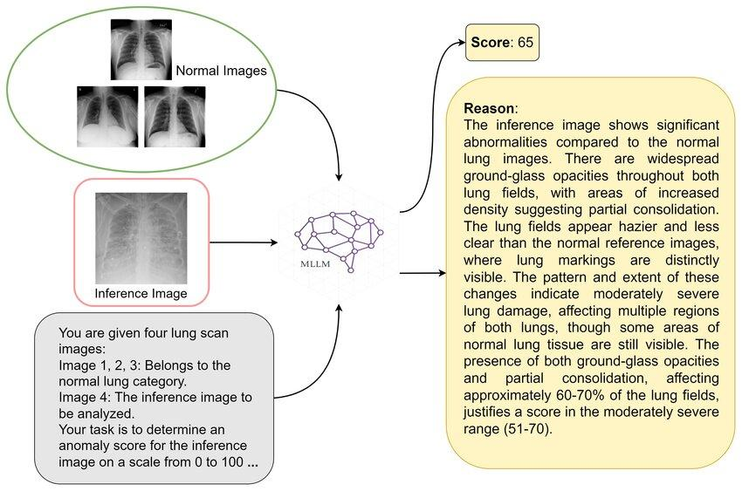
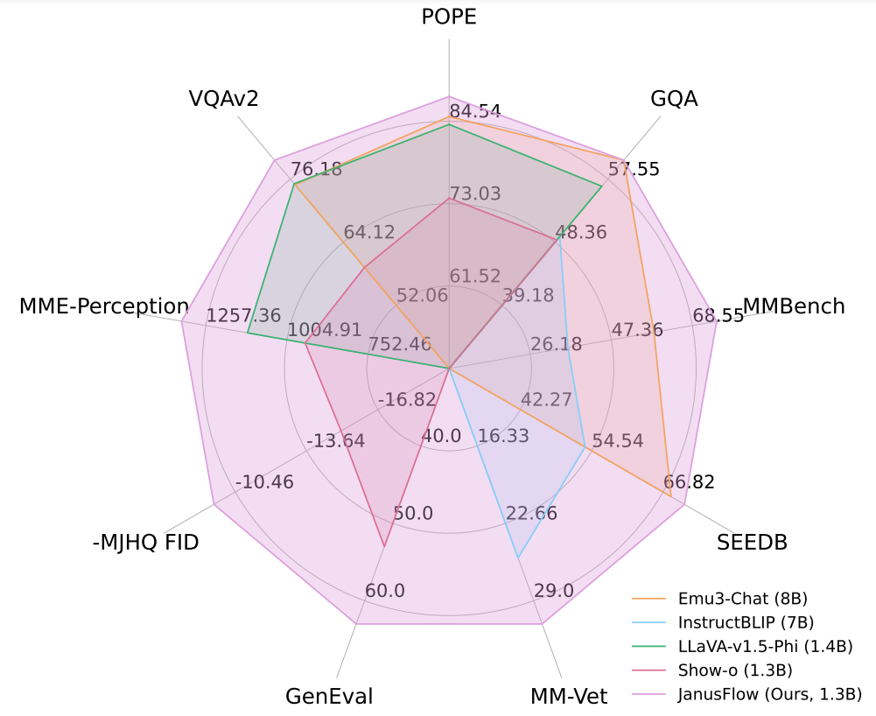
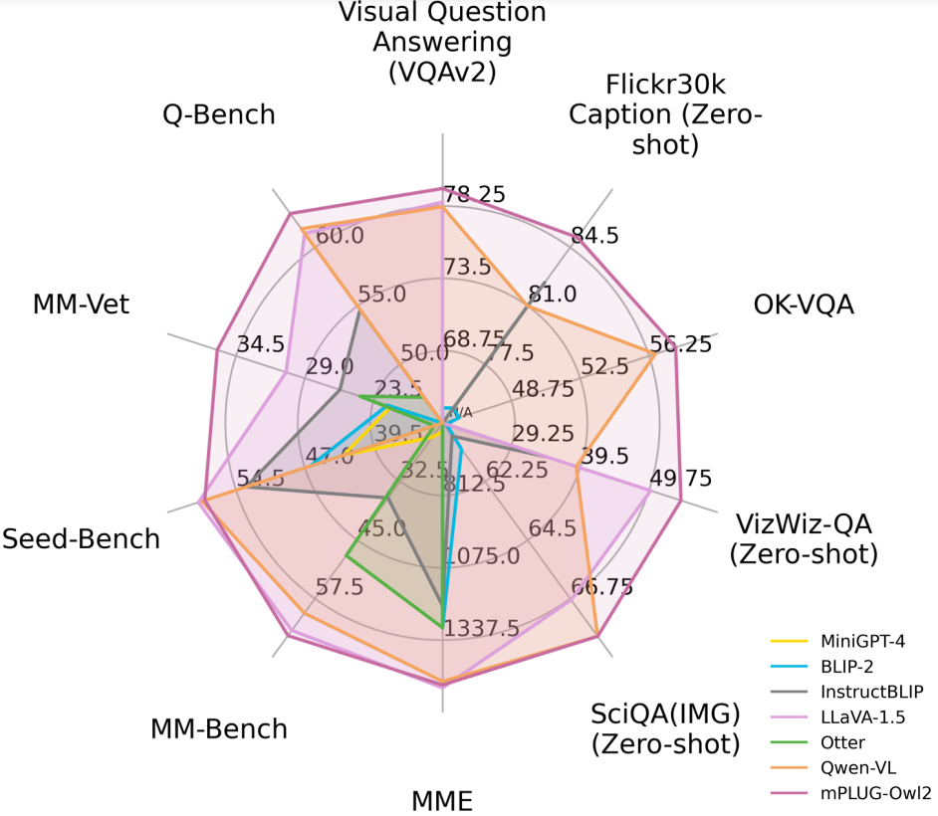
Connection Between Papers
Modality Integration
Unified Architecture
Architectural Innovations
Performance Benchmarks
Notes:
Modality Integration: Each model presents unique approaches to integrating visual and textual modalities. JanusFlow uses rectified flow, mPLUG-Owl2 employs modality collaboration, and Flamingo utilizes gated cross-attention.
Unified Architecture: All three models contribute to the development of unified architectures for multimodal tasks. JanusFlow and mPLUG-Owl2 explicitly aim for a single model capable of both understanding and generation, while Flamingo focuses on few-shot learning across various vision-language tasks.
Architectural Innovations: Each model introduces novel architectural elements: JanusFlow's integration of rectified flow, mPLUG-Owl2's modality-adaptive modules, and Flamingo's perceiver resampler.
Performance Benchmarks: These models set new performance standards in multimodal tasks, with JanusFlow and mPLUG-Owl2 claiming state-of-the-art results in their respective papers.

Slide 32
Attributions for Assets Used
https://en.wikipedia.org/wiki/File:Van_Gogh_-_Starry_Night_-_Google_Art_Project.jpg
https://artsology.com/blog/2022/09/van-gogh-and-basketball-as-imagined-by-ai/
https://medium.com/@tenyks_blogger/multimodal-large-language-models-mllms-transforming-computer-vision-76d3c5dd267f
https://openai.com/index/hello-gpt-4o/
http://dx.doi.org/10.48550/arXiv.2411.14515

